Slide 1
Period 6 10/12/ 12
1. Attendance
2. Brainpop on weather
3. New Notes - Weather
4. Brainpop on the atmosphere
5. Lab # 8 Layers of the atm

Slide 2
Period 9 10/11/ 12
1. Attendance
2. Test
  3. Pass Back

Slide 3
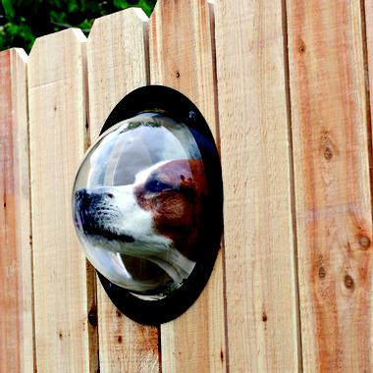
Using your senses is called:
Observation

Slide 4
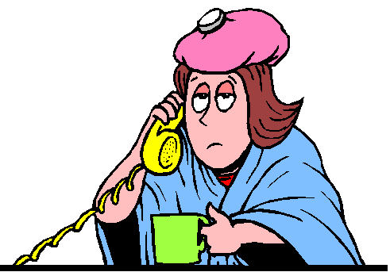
An assumption made on observations is called an
Inference

Slide 5
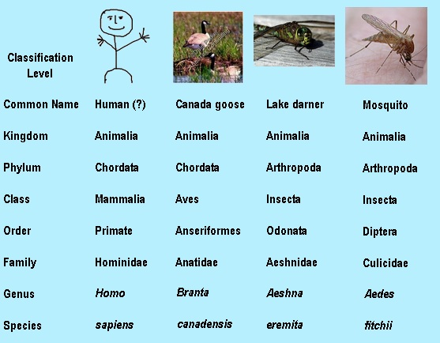
Grouping according to common characteristics is called
Classification

Slide 6
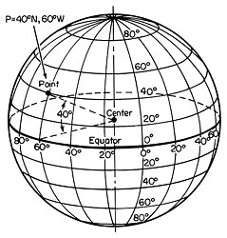
Navigation – determining your position on Earth

Slide 7
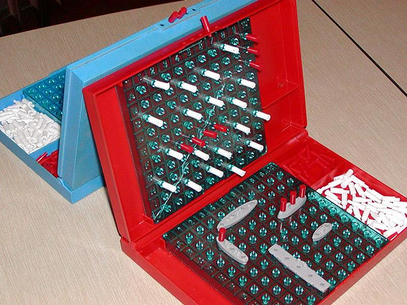
Coordinate Systems use two points to show location.

Slide 8
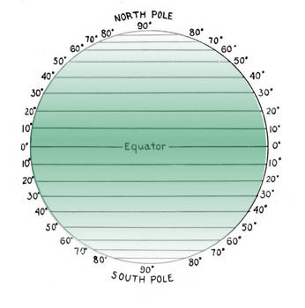
These are lines of…?

Slide 9
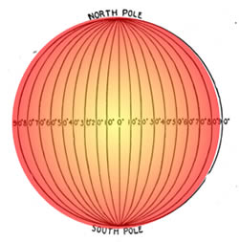
These are lines of…?

Slide 10
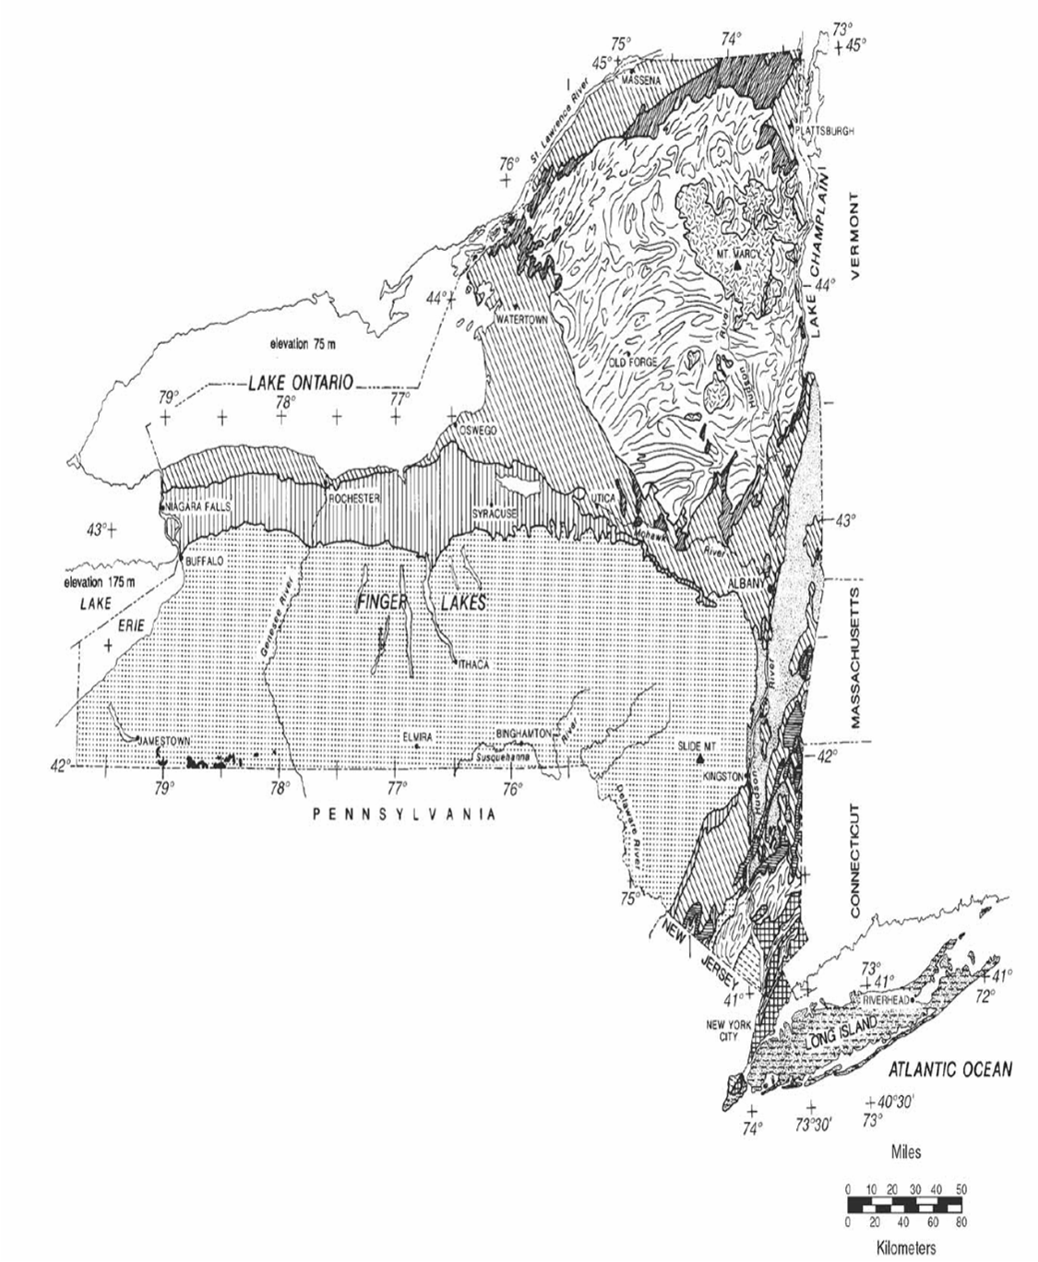

Slide 11
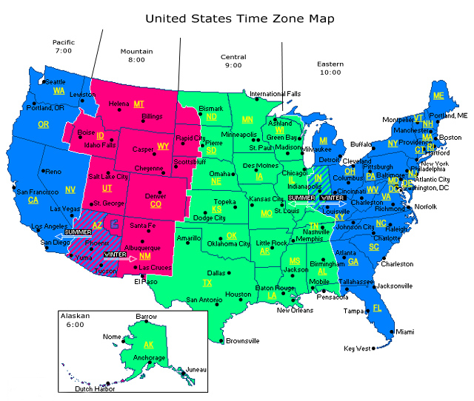

Slide 12
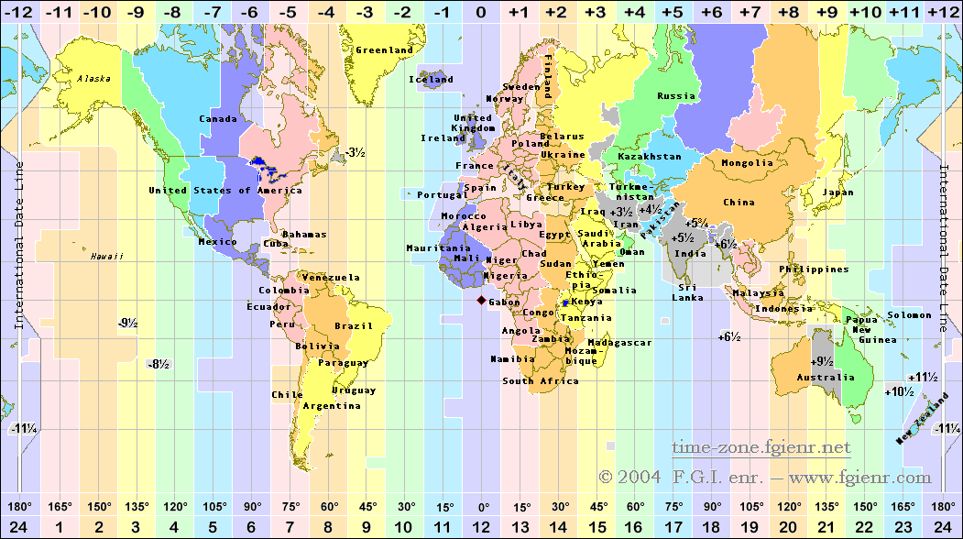

Slide 13
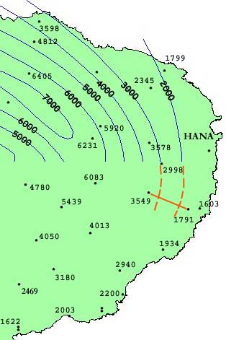
Isolines connect points of equal value.

Slide 14
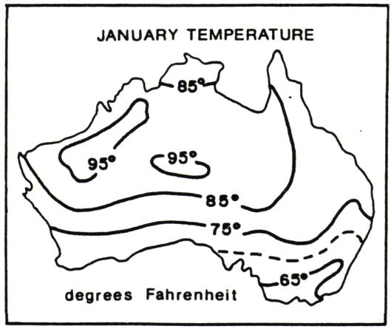
Isotherms – connect points of equal temperature

Slide 15
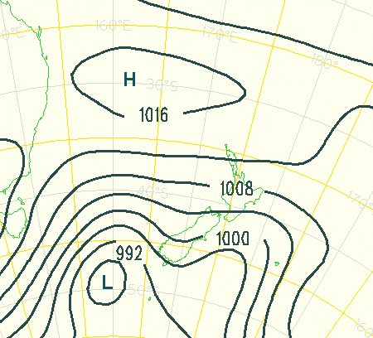
Isobars connect points of equal air pressure.

Slide 16
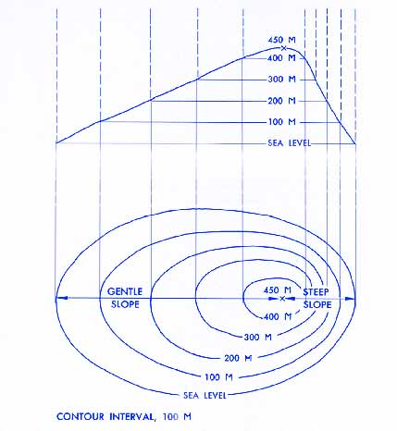
Contour lines connect points of equal elevation.

Slide 17
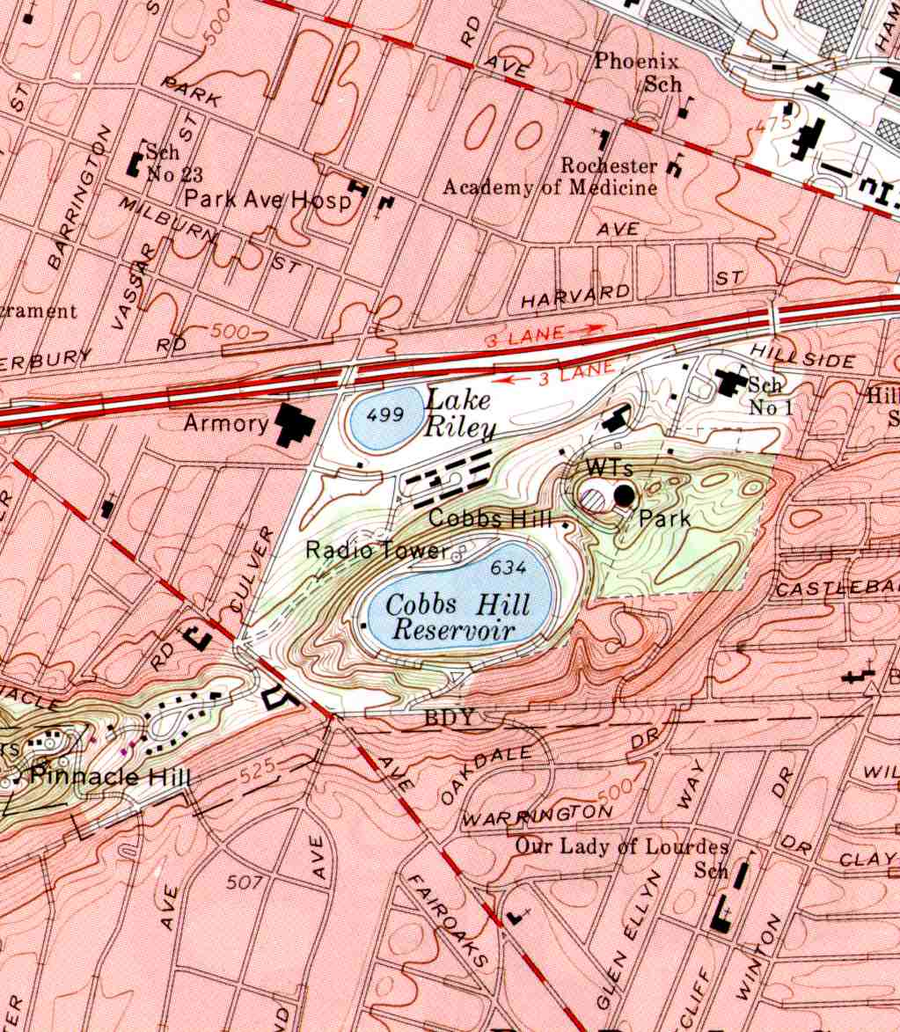

Slide 19
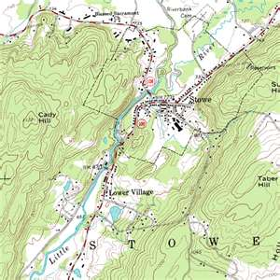
A real topographic map.

Slide 20
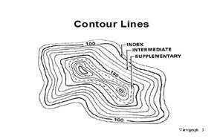

Slide 21
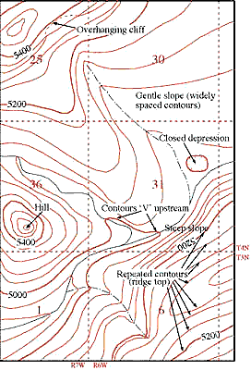

Slide 22
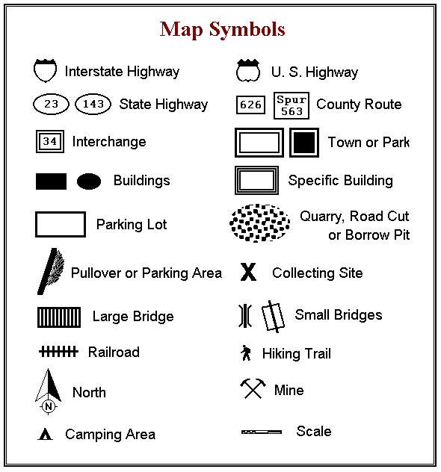

Slide 23
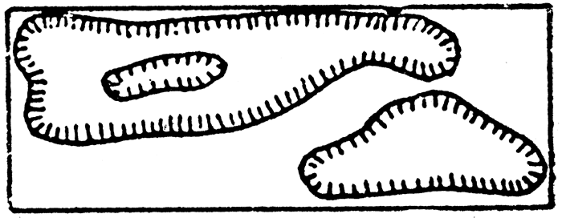
Depressions have hatchure lines.

Slide 24
http://www.tasagraphicarts.com/activities/profile.html

Slide 25
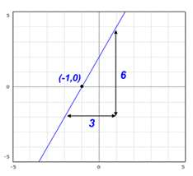
slope

Slide 26
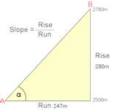
Slope

Slide 27
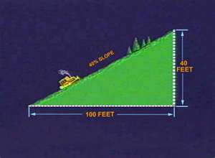
Gradient = slope

Slide 28
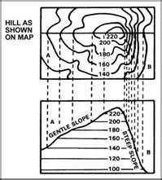
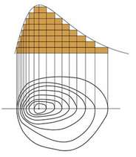

Slide 29
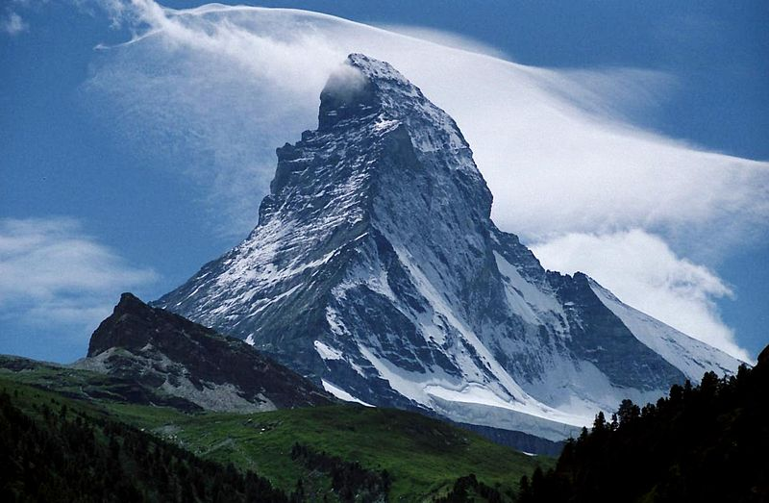
Gradient

Slide 30
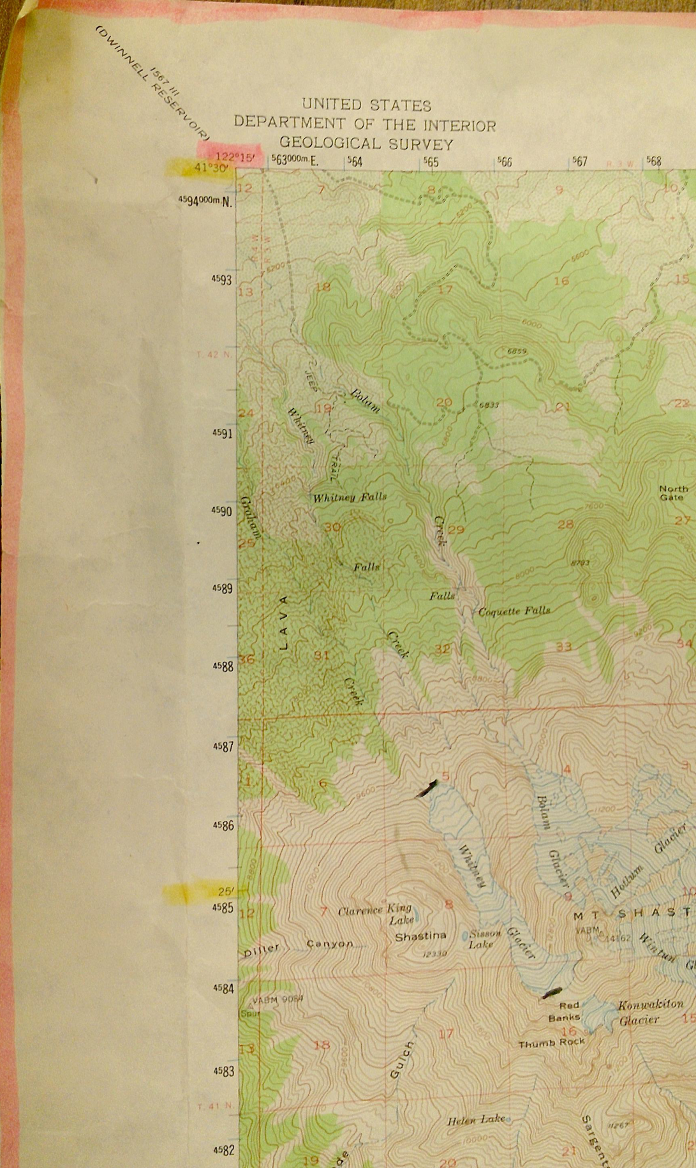
Longitude is in pink. Latitude is in yellow.

Slide 31
